Slide 1
Too vs. Very

Slide 2
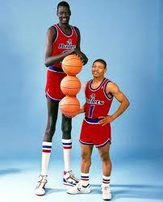
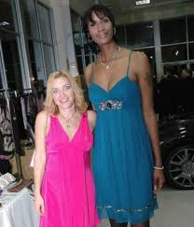
He is very tall.- She is really tall.

Slide 3
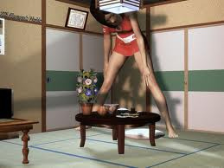
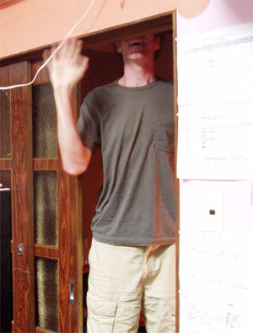
They are too tall.

Slide 4


Very = Positive meaning. Too = negative meaning.

Slide 5
Choose very or too. Check your answers by clicking on the arrow below.
1. I think James is nice. Karen thinks James is nice, too.James is ___ nice.
a) very
b) too

Slide 6
2. It's cold outside. I hate it. I might become sick if I go out.
It's ___ cold outside.
very
too

Slide 7
3. That box is so big. I can't pick it up.
That box is ___ big.
very
too

Slide 8
4. Tony's cat is fat. It weighs 8 kg.
Tony's cat is ___ fat.
very
too

Slide 9
5. Tony's cat is fat. It can't run. It may not live a long time.
Tony's cat is ___ fat.
very
too

